Slide 1
Time-Series Forecasting Using Auto encoders
SUBMITTED BY
RAMAPRIYA K
NM ID: au21CSA69
KGiSL INSTITUTE OF TECHNOLOGY
3/21/2024 Annual Review

Slide 2
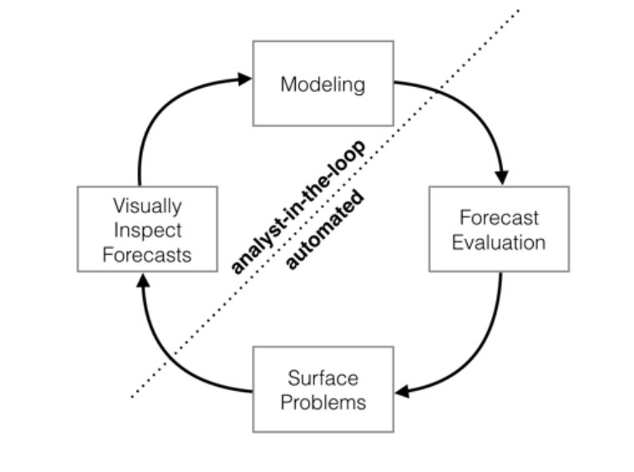
Time-Series Forecasting Using Autoencoders
3/21/2024 Annual Review

Slide 3


AGENDA
PROBLEM STATEMENT
PROJECT OVERVIEW
END USERS
SOLUTION AND PROPOSITION
KEY FEATURES
MODELLING APPROACH
RESULT
3/21/2024 Annual Review

Slide 4

PROBLEM STATEMENT
The project aims to develop an autoencoder-based approach for time-series forecasting, focusing on capturing temporal dependencies and patterns within the data to generate accurate predictions of future data points.
By leveraging the feature learning capabilities of autoencoders, we seek to extract salient features from time series data that can better capture its underlying structure and dynamics.
3/21/2024 Annual Review

Slide 5

PROJECT OVERVIEW
This project explores the application of autoencoders in time-series forecasting, aiming to develop a model capable of capturing intricate temporal patterns within sequential data.
By encoding and decoding time-series data, the autoencoder facilitates accurate predictions of future values, offering insights into future trends and behavior.
3/21/2024 Annual Review

Slide 6

WHO ARE THE END USERS?
Government Agencies and Policy Makers: Forecasting economic indicators, population growth, and environmental factors is crucial for policy making and long-term planning. Government agencies can utilize the forecasting model to inform policy decisions and develop strategies for sustainable development.
Supply Chain Managers: Forecasting accurate demand for products and raw materials is crucial for optimizing inventory levels, production schedules, and distribution logistics. Supply chain managers can leverage the forecasting model to improve efficiency and minimize costs.
3/21/2024 Annual Review

Slide 7

YOUR SOLUTION AND ITS VALUE PROPOSITION
The project involves generating synthetic time-series data, creating and training an autoencoder model, and evaluating its performance. The value proposition lies in the ability of the autoencoder to capture temporal patterns within the data and generate accurate predictions of future values. This solution offers insights into future trends and behavior, facilitating informed decision-making in various domains such as finance, energy, and healthcare.
3/21/2024 Annual Review

Slide 8
THE WOW IN YOUR SOLUTION
Enabling accurate forecasting of future values
Learns meaningful representations from sequential data
Better understanding
Better prediction of complex temporal dynamics
Decision making across various domains
Offers insights into future trends
Improved Accuracy, Scalability and interpretability of forecasts
3/21/2024 Annual Review

Slide 9
MODELLING
AUTOENCODER MODEL:
The autoencoder model consists of LSTM (Long Short-Term Memory) layers.
It takes a sequence of input data points and learns to encode them into a lower-dimensional representation.
The encoded representation is then decoded back to the original sequence using another set of LSTM layers.
The autoencoder is trained to minimize the mean squared error loss between the input and output sequences, effectively learning to reconstruct the input sequence.
SEQUENCE GENERATION MODEL:
After training the autoencoder, a separate function is used to generate new sequences of future data points.
This function takes a seed sequence as input and iteratively generates new data points by feeding the previous data point into the autoencoder.
The autoencoder learns to predict the next data point based on the previous ones, capturing temporal dependencies in the data.
3/21/2024 Annual Review

Slide 10
DATA GENERATION:
Synthetic time-series data is generated with two sine waves and random noise using the “generate_time_series_data” function.
2. MODEL CREATION AND TRAINING:
An autoencoder model is created using LSTM layers with specified architecture in the “create_autoencoder” function.
The autoencoder model is trained on the generated time-series data using the “train_autoencoder” function. The model is optimized to minimize the mean squared error loss between the input and output sequences.
3. SEQUENCE GENERATION:
After training the autoencoder, a new sequence of future data points is generated using the “generate_new_sequence” function.
This function takes a seed sequence and iteratively predicts future data points based on the learned patterns in the autoencoder model.
4. VISUALIZATION:
Finally, the original seed sequence and the generated future sequence are plotted for comparison using Matplotlib.

Slide 11
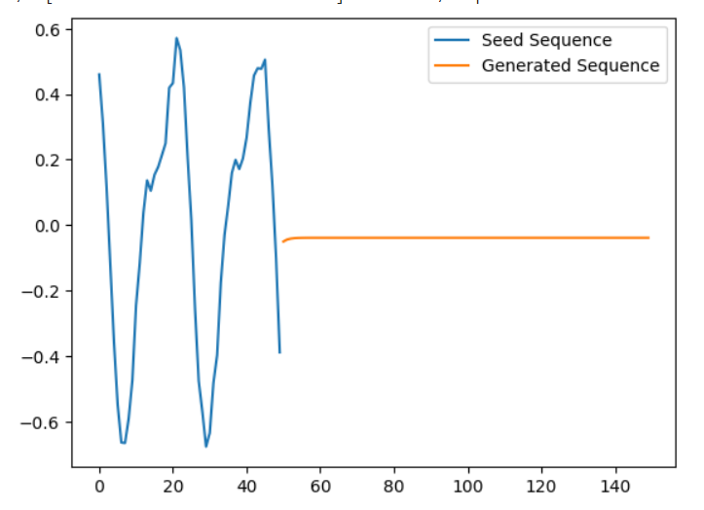
RESULTS
The project's results demonstrate the autoencoder's ability to accurately forecast future values in time-series data, showcasing its effectiveness in capturing temporal patterns and generating precise predictions.
https://drive.google.com/file/d/1E2lLc1FGSRKmYAylv0-BC-nsH2qHvzf7/view?usp=sharing
3/21/2024 Annual Review

